Slide 1
TEBONG ROLANDDSC 640 –T302 Data Presentation & Visualization (2241-1)
5.3 Project Task 4: Infographic

Slide 2


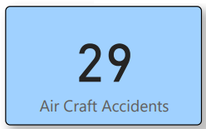
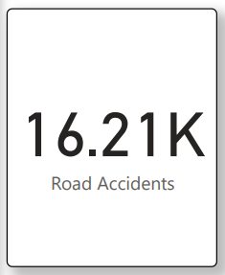
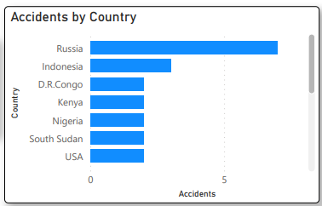
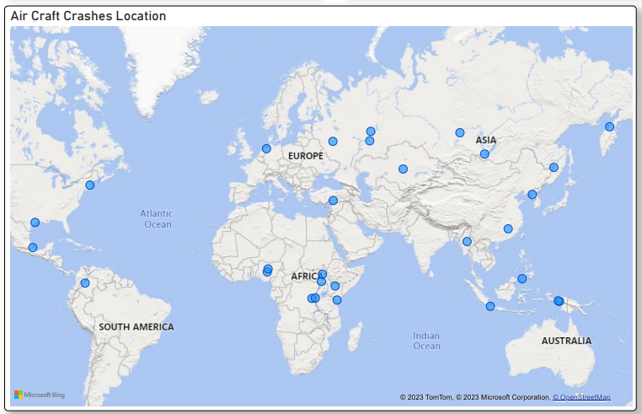
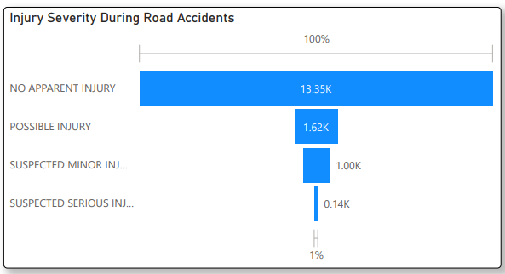
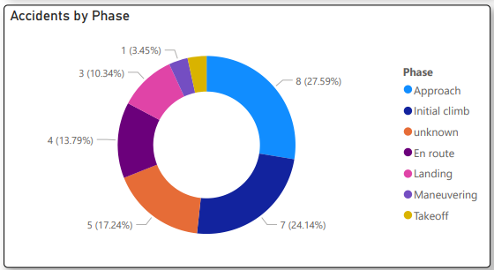

Air Travel Safety Unveiled in 2021
Road accidents significantly exceed aircraft incidents.
Russia & Indonesia have most Accidents
Injury severity in road accidents: An eye-opening look at the numbers and consequences
A world map with markers for aviation accidents
Accidents by Phase: A breakdown of incidents from takeoff to landing, uncovering trends and patterns

